Slide 1

Creating a fire alarm using household IOT sensors
Gabi Rivera, Sahil Wadhwa, and Liam Richardson

Slide 2
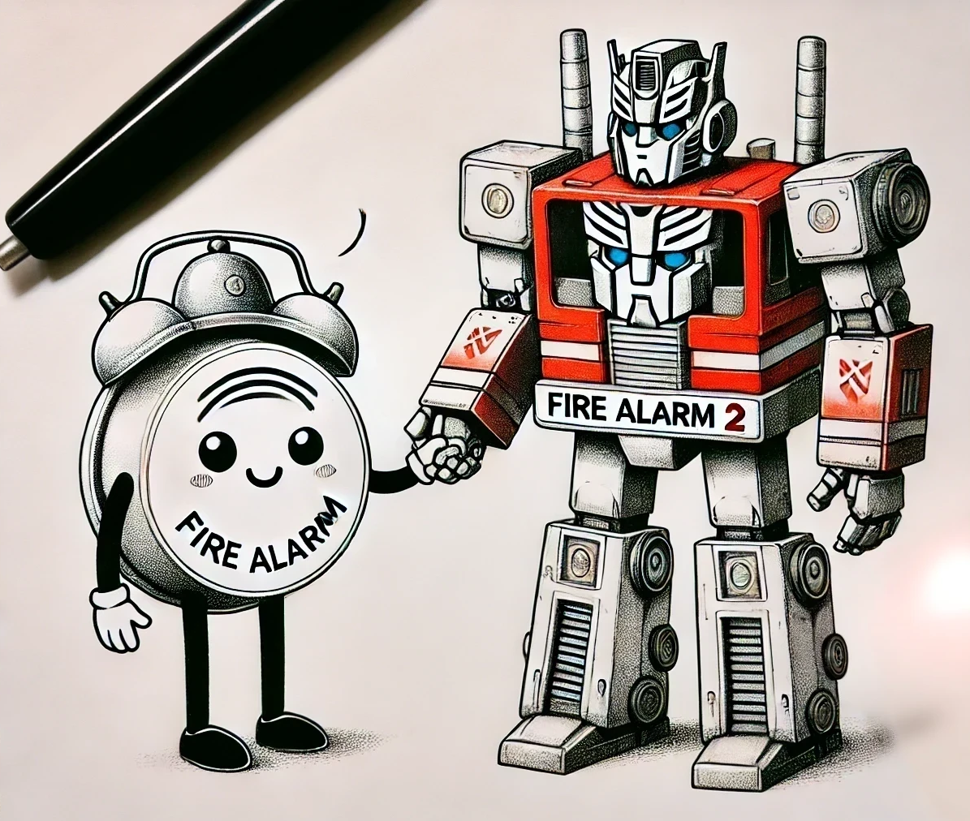

Introduction
Fire alarms save lives, but their efficacy is stifled by false alarms and hardware issues.
It has been noted that by fusing data from common household IOT sensors, one can produce a makeshift fire alarm.
This second fire alarm can be used in conjunction with traditional fire alarms to increase the confidence of a reported fire.
This project aims to train several models on IOT data to create a secondary fire alarm

Slide 3
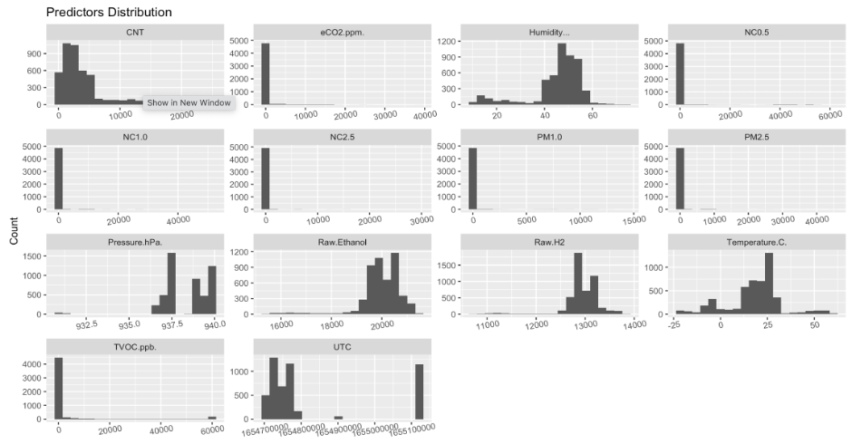
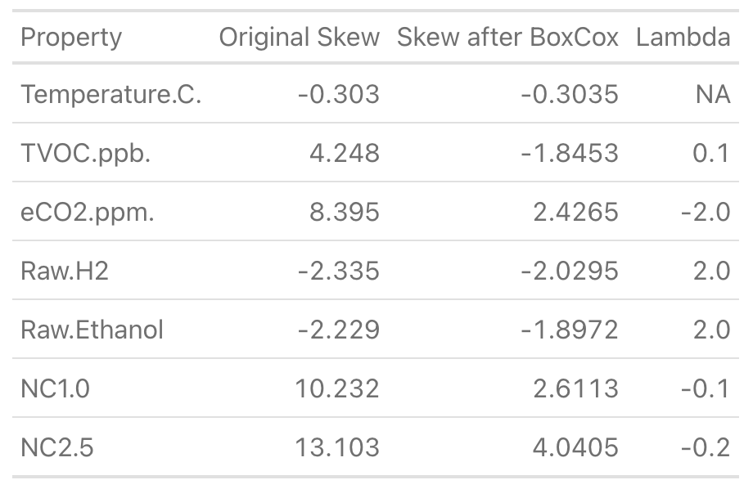
Data Preprocessing
General Data Info
5,000 obs.
14 numerical features
1 binary outcome (Yes and No)
No missing values
Transformations
UTC to hour, day, month, & year format
Predictors with high Pearson Correlation Score >0.75 were removed reducing predictors to 7 variables
No predictor with <0.5 skewness score after Box-Cox Transformation
Center & Scale was performed before running the predictors into the models
Data Splitting
80% Train set and 20% Test set
Train set rebalanced (ROSE)

Slide 4
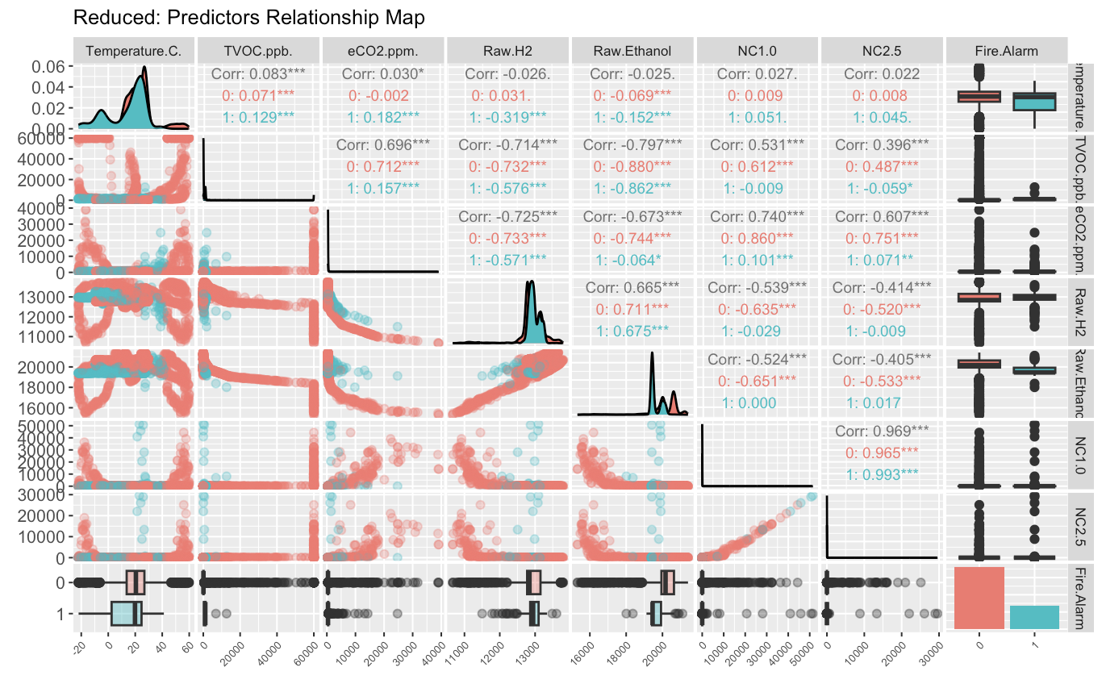
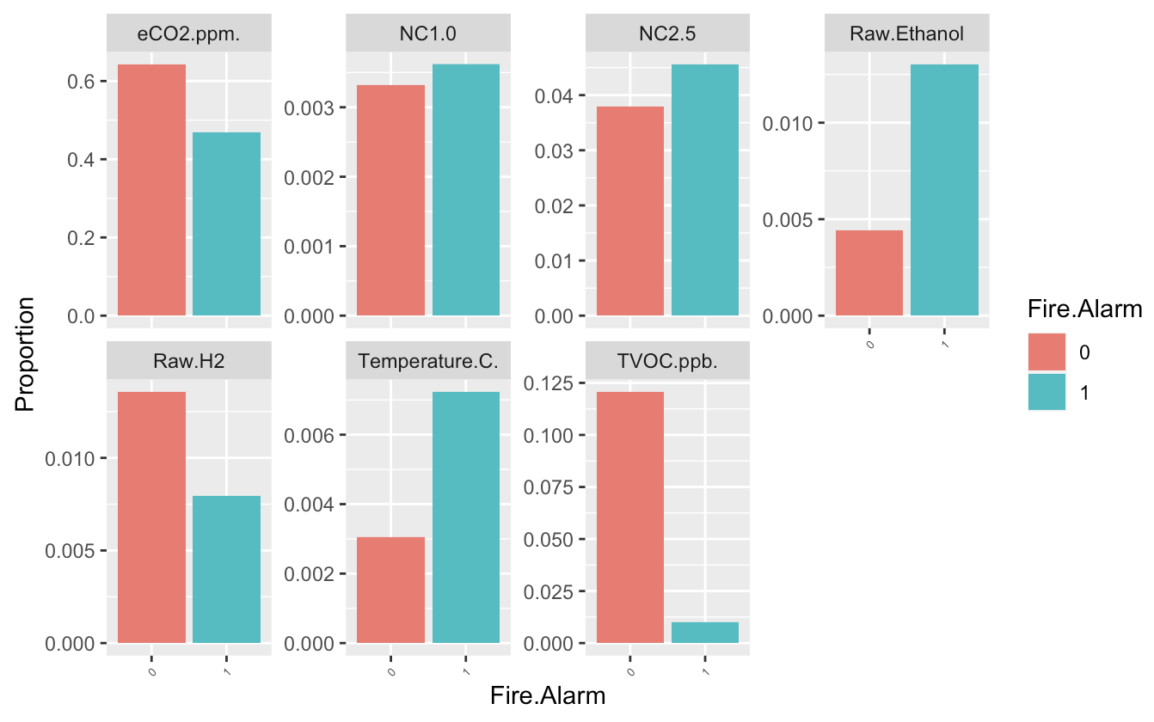
Exploratory Data Analysis
*NC (Concentration of Particulate)
*TVOC (Total Volatile Organic Compounds)
*eCO2 (CO2 equivalent)

Slide 5
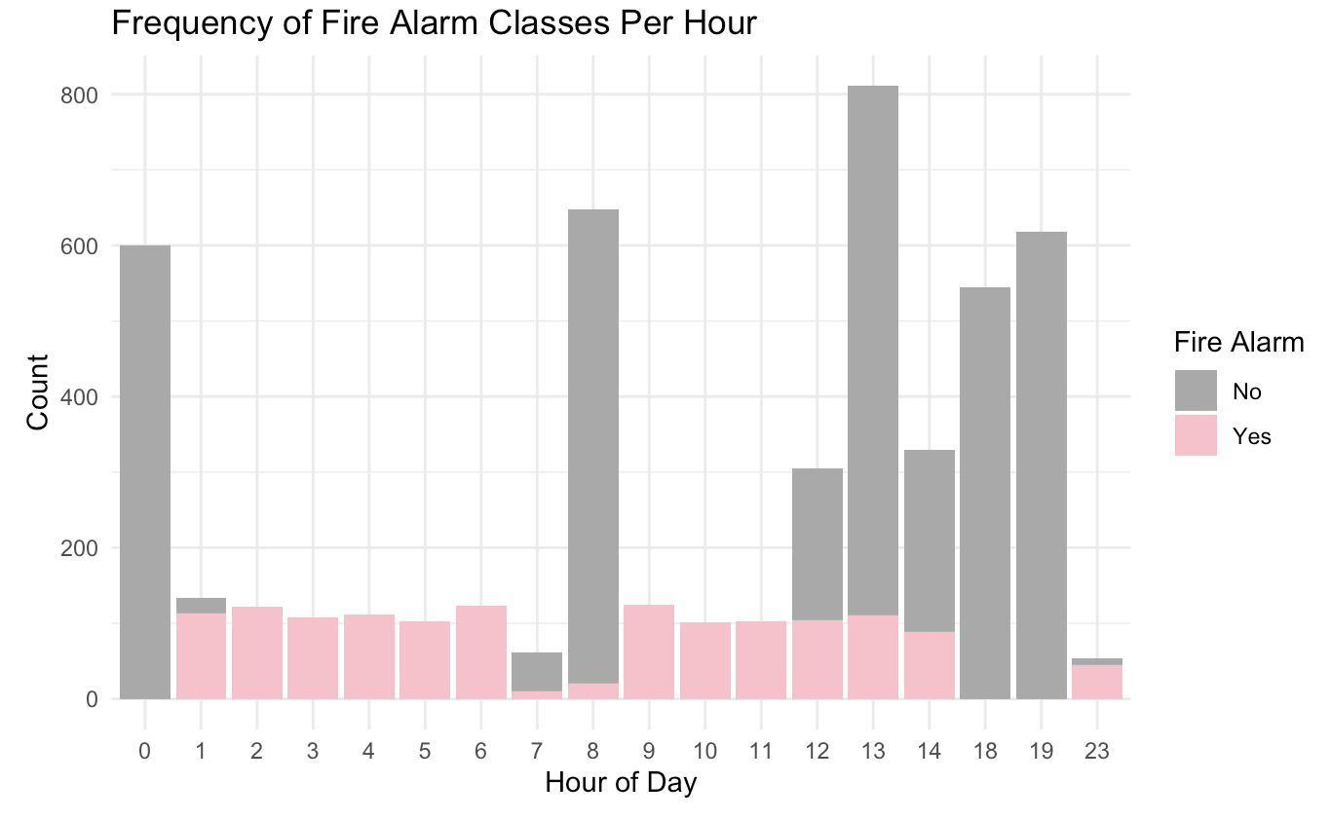
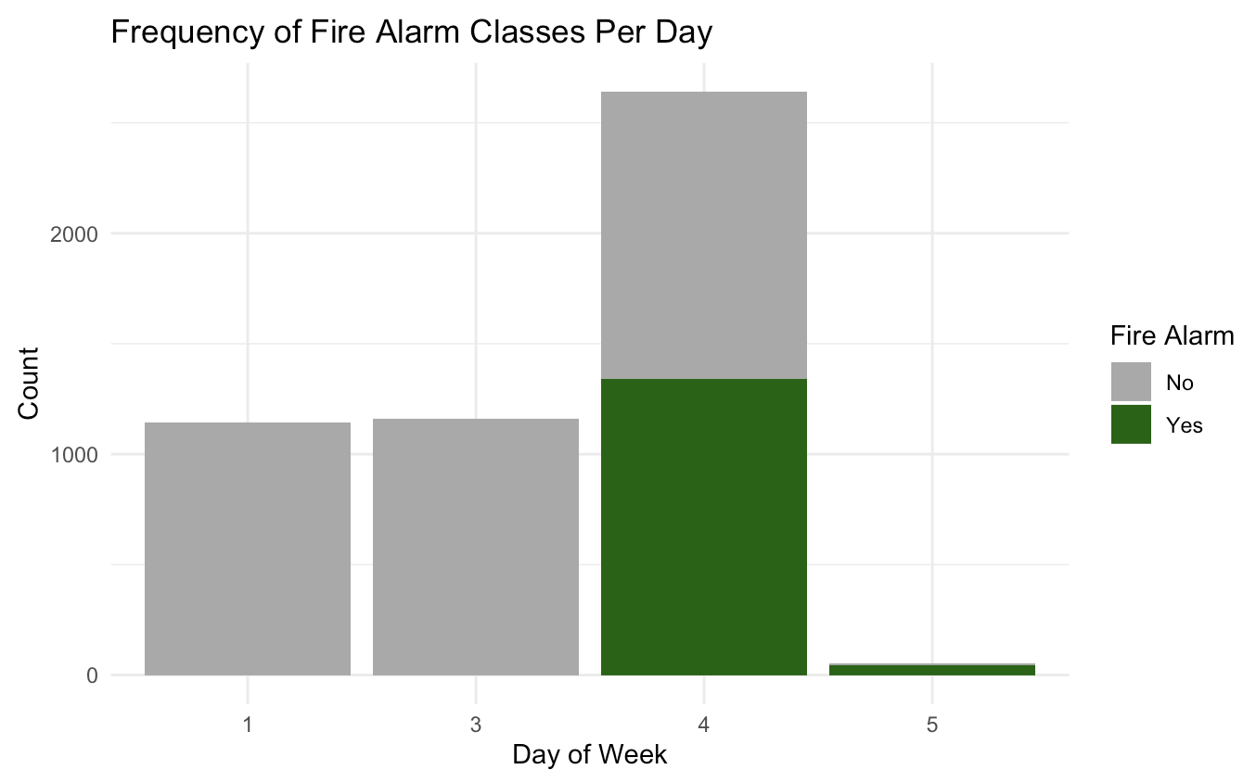
Exploratory Data Analysis

Slide 6

Model Strategies
As a fire alarm is essentially a binary classification problem, we opted for models which are intended for classification
Of these: KNN, NSC and Logistic Regression are explicitly designed for classification. For the other models the following adjustments were made:
A softmax activation function + a cross entropy loss function was selected for the neural network to be appropriate for classification.
A radial basis function was selected for the SVM.
Fire alarm was set as a factor in R to indicate to the MARS model that this is a regression task.

Slide 7

Model Tuning
Model Name | Tuned Hyperparameters | Optimal Value
Logistic Regression | N/A | N/A
NSC | shrinkage | 11
SVM | cost,sigma | sigma=4 cost=14
Neural Net | Hidden layer width,depth, learning rate | 8 hidden layer neurons, 1 hidden layer, lr=.01
MARS | Number of features | 11
KNN | Number of neighbors | 1

Slide 8

Results and Model Selection
-Accuracy used as the metric on the test set
-Top models were NNET and SVM
-Worst model was MARS
-Other four in the middle
Model | Accuracy
NNET (Neural Network) | 0.995
SVM (Support Vector Machine) | 0.977
PLR (Penalized Logistic Regression) | 0.758
KNN (K Nearest Neighbors) | 0.755
LR (Logistic Regression) | 0.752
NSC (Nearest Shrunken Centroids) | 0.733
MARS (Multivariate Adaptable Regression Spline) | 0.674

Slide 9
Conclusion and Next Steps
-Fire alarms are more important than we realize
-Continue to do more research using more datasets to test out the chosen models
-Don’t give up on the models that didn’t work
-Try to implement the use of educational reach to make this topic more talked about

Slide 10
References
OpenAI. (n.d.). ChatGPT. Retrieved June 01, 2024, from https://www.openai.com/chatgpt
Istre, G. R., & Mallonee, S. (2000). Smoke alarms and prevention of house-fire-related deaths and injuries. The Western journal of medicine, 173(2), 92–93. https://doi.org/10.1136/ewjm.173.2.92
Molino-Minero-Re, E., Aguileta, A. A., Brena, R. F., & Garcia-Ceja, E. (2021). Improved Accuracy in Predicting the Best Sensor Fusion Architecture for Multiple Domains. Sensors (Basel, Switzerland), 21(21), 7007. https://doi.org/10.3390/s2121700

Slide 11


